Slide 1
Back End Engineering Project
Title :
Villa Venezia
Team Details :
Jasmeen kaur , 2310992025
Khushi , 2310992039
Faculty Coordinator :
Mrs . Vijaita Kashyap
:
Chitkara University Institute of Engineering and Technology,
Chitkara University, Punjab

Slide 2

INTRODUCTION
What is the Purpose of Our Villa Venezia?
To provide an easy-to-use platform that simplifies hotel booking and makes it accessible to everyone.
To offer a seamless booking experience with a user-friendly interface and efficient management of hotel data on the backend.

Slide 3

KEY FEATURES
Key Features Implemented:
Homepage : A simple, attractive layout with navigation options.
Registration System : Allows users to create accounts by entering their details.
Backend Integration : Captures and stores user data in a JSON file.

Slide 4

TECHNICAL DETAILS
Frontend:
HTML : Structure of the website.
CSS : Styling for the webpage elements.
JavaScript : Adds interactivity to the homepage and registration page.
Backend:
Node.js for handling user input and requests.
Database:
JSON file used for storing user data entered during registration.

Slide 5
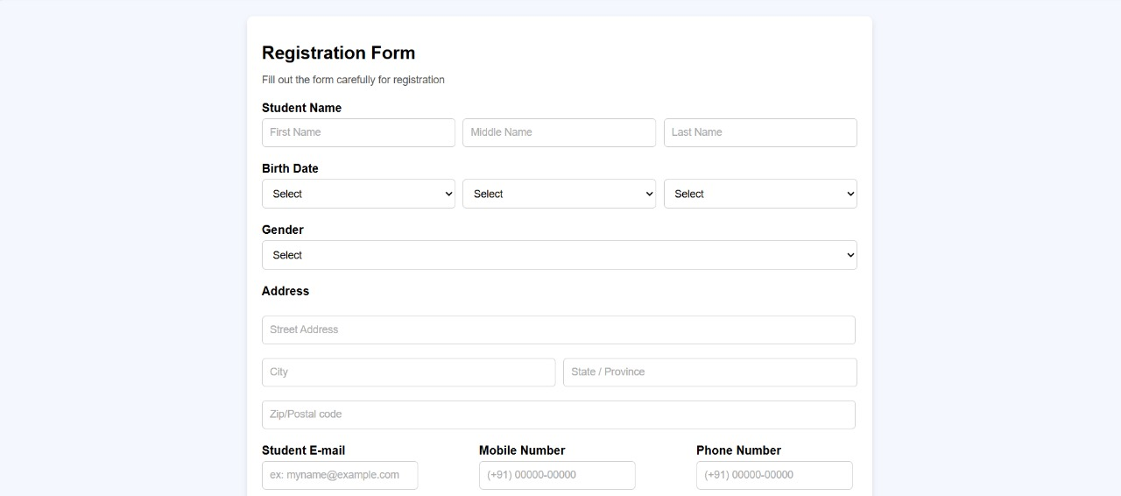

PROJECT HIGHLIGHTS

Slide 6
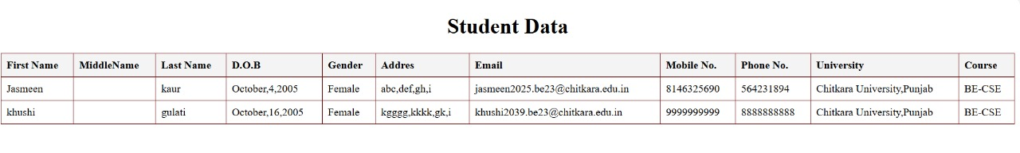

Slide 7

CONCLUSION
The hotel booking platform includes:
A functional homepage.
A registration system for users to create accounts.
Backend data storage and dynamic display of user information.
Functionality :
Users search and book hotels by entering their details, which are stored and displayed dynamically.
Demonstrates the core feature of hotel booking, essential for travel platforms.

Slide 8


FUTURE SCOPE
Add more pages for hotel details and user profiles.
Advanced search filters (like location etc.)
Guest Reviews and Ratings for hotels.
Add interactive features like room availability filters and price comparison.
Real-time booking updates and notifications.

Slide 9


